Slide 1
Demo
Image Super Resolution using GANs
Harsh Modi
Trupti Gore

Slide 2
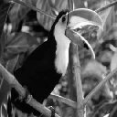
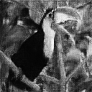
Real | Generated

Slide 3

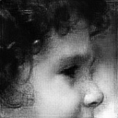
Real | Generated

Slide 4

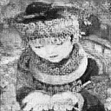
Real | Generated

Slide 5

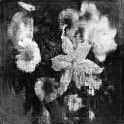
Real | Generated

Slide 6
Thank you

